Slide 1
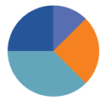
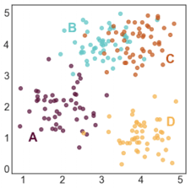
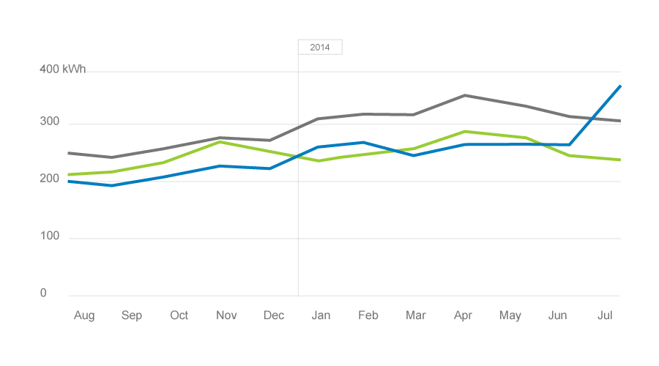
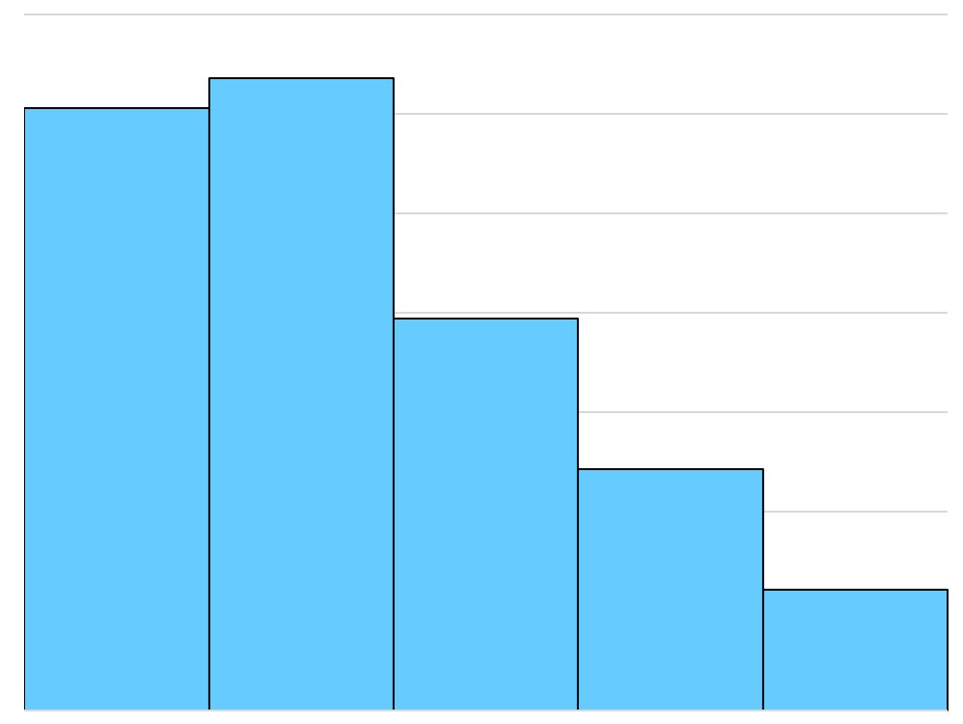
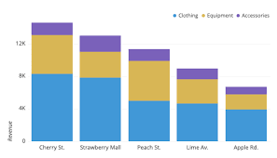
TOTAL # OF SURVEY RESPONSES (TEXT)
Division of respondents by age group
Average of balance scores overtime
Distribution of respondents in the 3 balance score ranges
Frequency of categorical responses based on balance score range
Average rating for each category for each of the balance score ranges (each ‘stack’ within each bar = 1 balance score range)

